Slide 1
Cs 429: DATA MINING Lecture 4

Slide 2
Output
Decision Tables
Decision Trees
Classification Rules
Association Rules
Rules with Exceptions
Rules involving Relations
Trees for Numeric Prediction
Instance-based Representation
Clusters

Slide 3
Association Rules
Predict any attribute (besides class)
Predict combinations of attributes
Not to be used as a Rule Set
Coverage or Support: Number of Instances for which an Association Rule predicts correctly (Number or %)
Accuracy or Confidence: Ratio of Support and Number of Instances for which an Association Rule applies (%)
If temperature = cool then humidity = normal

Slide 4
Association Rules
Minimum Support and Confidence
Misinterpretation
If windy = false and play = no then outlook = sunny and humidity = high
≠
If windy = false and play = no then outlook = sunny
If windy = false and play = no then humidity = high

Slide 5
Output
Decision Tables
Decision Trees
Classification Rules
Association Rules
Rules with Exceptions
Rules involving Relations
Trees for Numeric Prediction
Instance-based Representation
Clusters

Slide 6
Rules with Exceptions
Incremental modifications to Rule Set
Exceptions to Rules, not to Rule Set

Slide 7

Rules with Exceptions
New Instance
Applied Rules
Exception
If petal-length ≥ 2.45 and petal-length < 4.45 then Iris-versicolor
If petal-length ≥ 2.45 and petal-length < 4.95 and petal width < 1.55 then Iris-versicolor
If petal-length ≥ 2.45 and petal-length < 4.45 then Iris-versicolor
EXCEPT if petal-width < 1.0 then Iris-setosa

Slide 8
Rules with Exceptions
Exceptions as Concept Description
default: Iris-setosa
except if petal-length ≥ 2.45 and petal-length < 5.355
and petal-width < 1.75
then Iris-versicolor
except if petal-length ≥ 4.95 and petal-width < 1.55
then Iris-virginica
else if sepal-length < 4.95 and sepal-width ≥ 2.45
then Iris-virginica
else if petal-length ≥ 3.35
then Iris-virginica
except if petal-length < 4.85 and sepal-length < 5.95
then Iris-versicolor

Slide 9
Output
Decision Tables
Decision Trees
Classification Rules
Association Rules
Rules with Exceptions
Rules involving Relations
Trees for Numeric Prediction
Instance-based Representation
Clusters

Slide 10
Rules involving Relations
Propositional Rules
Tests attribute values against constants
Denotes facts about attributes
Relational Rules
Compares two or more attribute values
Express relationships between attributes

Slide 11
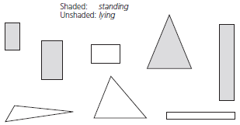
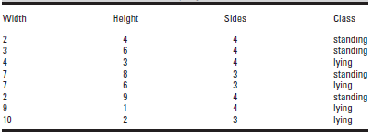
Rules involving Relations
Shapes Problem

Slide 12
Rules involving Relations
Propositional Rule
Relational Rule
Decision Trees?
If width ≥ 3.5 and height < 7.0 then lying
If height ≥ 3.5 then standing
If width > height then lying
If height > width then standing

Slide 13
Rules involving Relations
Propositional Rule Set using Relations
Categorical attributes?
S# | Width | Height | Sides | Width<Height | Class
1 | 2 | 4 | 4 | Yes | standing
2 | 3 | 6 | 4 | Yes | standing
3 | 4 | 3 | 4 | No | lying
4 | 7 | 8 | 3 | Yes | standing
5 | 7 | 6 | 3 | No | lying
6 | 2 | 9 | 4 | Yes | standing
7 | 9 | 1 | 4 | No | lying
8 | 10 | 2 | 3 | No | lying
If width<height = yes then standing
Else lying

Slide 14
Output
Decision Tables
Decision Trees
Classification Rules
Association Rules
Rules with Exceptions
Rules involving Relations
Trees for Numeric Prediction
Instance-based Representation
Clusters

Slide 15
Trees for Numeric Prediction
Regression Trees: Regression in Decision Trees
PRP = -55.9 + 0.0489 MYCT + 0.0153 MMIN + 0.0056 MMAX + 0.6410 CACH - 0.2700 CHMIN + 1.480 CHMAX

Slide 16
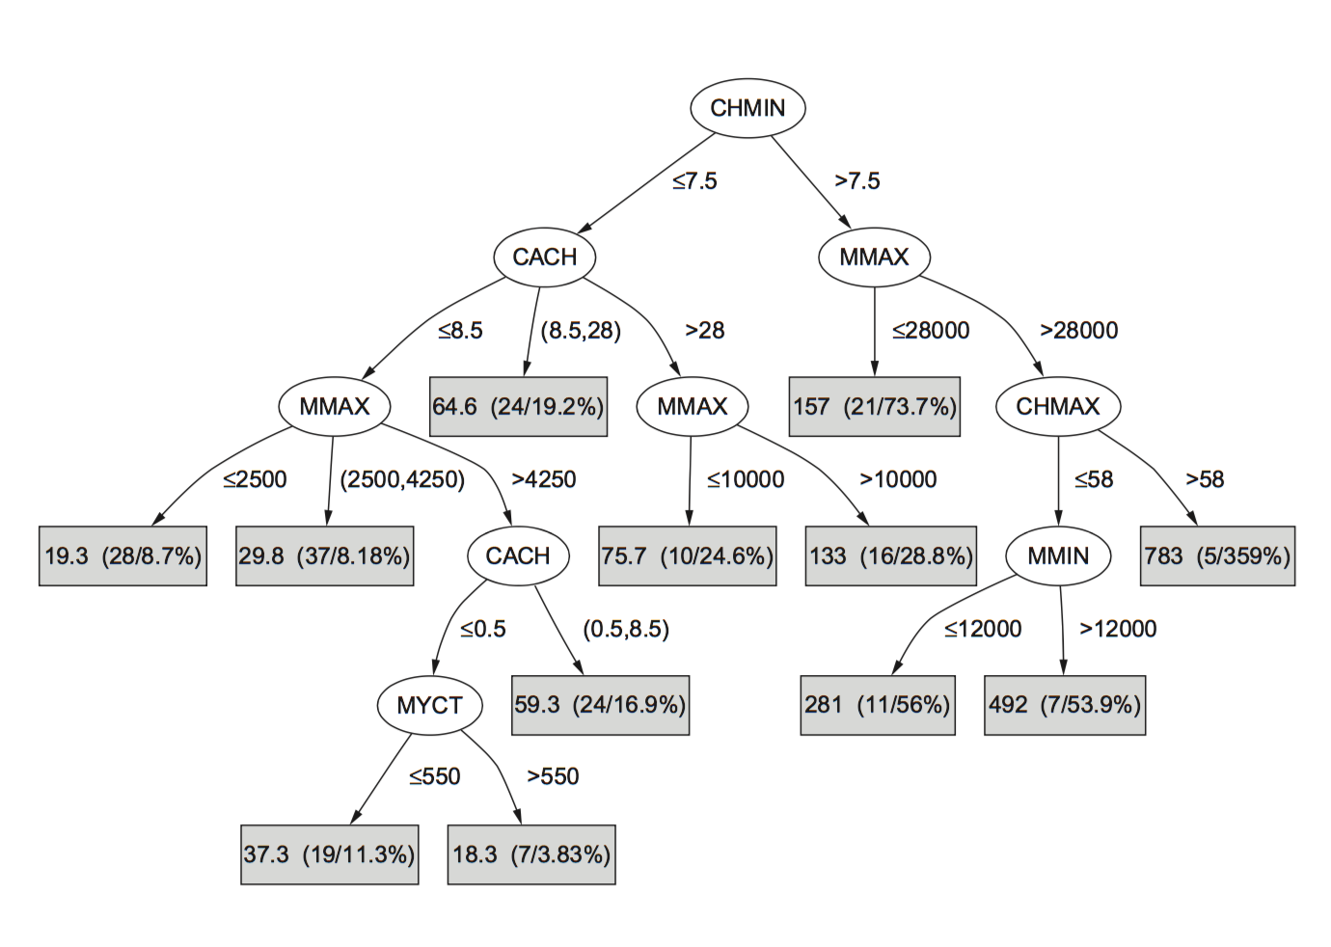
Trees for Numeric Prediction
Regression Trees

Slide 17
Trees for Numeric Prediction
Characteristic | Regression Equation | Regression Trees
Size | Small | Large
Complexity | Less | More
Clarity | More | Less
Accuracy | Low | High

Slide 18
Output
Decision Tables
Decision Trees
Classification Rules
Association Rules
Rules with Exceptions
Rules involving Relations
Trees for Numeric Prediction
Instance-based Representation
Clusters

Slide 19
Instance-based Representation
Rote Learning
Comparison using Distance metric
Nearest-Neighbor Classification
K-Nearest-Neighbor Classification
Categorical vs. Numeric Class
Equally Significant Attributes?
Categorical vs. Numeric Attributes
Cost: Space and Time

Slide 20

Instance-based Representation
Existing Structure used
Instances instead of Rules, Trees, etc.
Learning at run-time

Slide 21
Output
Decision Tables
Decision Trees
Classification Rules
Association Rules
Rules with Exceptions
Rules involving Relations
Trees for Numeric Prediction
Instance-based Representation
Clusters

Slide 22
Clusters
Groups in which Instances fall
Types:
Unique Associations
Overlapping Subsets - Venn Diagram
Probabilistic Associations
Hierarchical Associations - Dendrograms

Slide 23
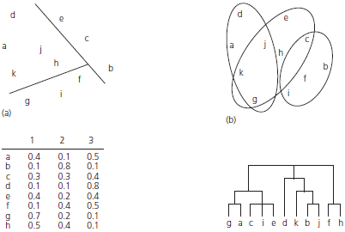
Clusters
Types:

